Slide 1
Bringing in Functionality Using Bootstrap Components

Slide 2

Overview
Understanding Bootstrap Components
Adding components to our pages
Jumbotron
Nav and Navbar

Slide 3
Understanding Bootstrap Components

Slide 4

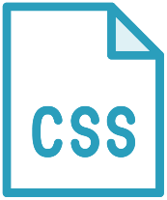

Bootstrap Components
Ready-made building blocks
Work using CSS classes
Sometimes require jQuery for interactivity

Slide 5
Basic Bootstrap Components
Progress
Button
Jumbotron
Nav & Navbar
Card
Forms

Slide 6

Demo
Working with the Progress component
https://getbootstrap.com/docs/4.5/components/progress/

Slide 7
Adding Components to Our Pages

Slide 8
Demo
Adding the Jumbotron component to the detail page

Slide 9
Demo
Adding navigation to the site using nav and navbar

Slide 10
Summary
Components can be used to introduce otherwise complex functionality to a site
Some components require support of jQuery to unleash their functionality

Slide 11


Up next:
Creating a Bootstrap- enabled form

